Slide 1
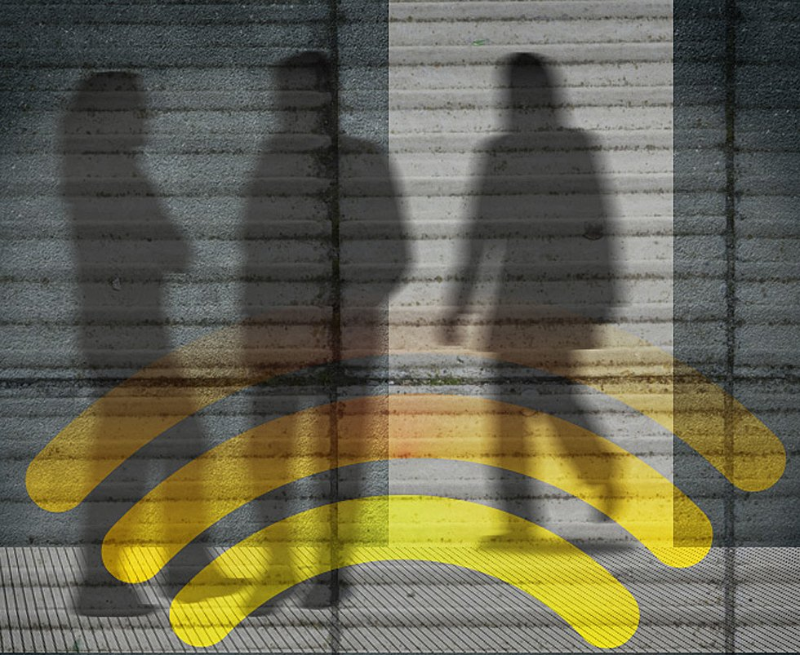
WiFi-POWERED HUMAN TRACKING THROUGH WALLS
TEAM MEMBERS :-
KARUNYA V
KAVITHA S
LAVANYA DEVI S
MADHUMITHA V

Slide 2
ABSTRACT
This project develops a non-invasive human tracking system using WiFi signals to monitor movement through walls and obstacles. By leveraging Channel State Information (CSI) from standard routers and specialized receivers, the system detects motion-induced variations in signal characteristics—such as amplitude, phase, and Doppler shifts—without requiring wearable sensors or cameras.
Machine learning models, including CNNs for posture estimation and RNNs for motion recognition, interpret CSI data, while real-time visualization techniques like heatmaps and skeletal models enhance analysis.
Designed for security surveillance, elderly care, smart homes, and disaster response, the system ensures privacy, scalability, and cost-efficiency by utilizing existing WiFi infrastructure and open-source tools.

Slide 3
NOVELTY
This approach optimizes energy-efficient signal processing using lightweight algorithms, edge computing, and compressed sensing to reduce computational overhead.
Low-power AI models with pruning, quantization, and Tiny ML enable efficient tracking with event-triggered activation. Passive sensing leverages existing WiFi reflections, eliminating the need for additional transmissions.
Smart CSI extraction with adaptive sampling and feature selection minimizes processing requirements, while power management techniques like duty cycling and sleep modes further enhance efficiency, making the system sustainable and low-power.

Slide 4




SOFTWARE USED
1 . LINUX [operating system]
2. LINUX [CSI extraction]
3. PYTHON , MATLAB [Programming language]
4. VISUALIZATION [Matplotlib, Open CV, Seaborn]
5. DATA PROCESSING & ANALYSIS [Numpy]

Slide 5
APPLICATIONS
Defence: Track suspects or hostages inside buildings during operations
Home Security: Intruder detection and surveillance without cameras.
Healthcare: Elderly and patient monitoring.
Search and Rescue – Locate missing persons or victims in disaster zones without physical entry.
Industrial: Worker safety and asset tracking.
Smart Cities: Crowd monitoring and public safety

Slide 6
FUTURE SCOPE
Enhanced Accuracy & Multi-Person Tracking – Improve machine learning for precise detection and differentiation.
Smart Integration – Connect with smart homes, healthcare, and automation systems.
Healthcare Applications – Enable fall detection, sleep monitoring, and movement analysis.
Advanced Localization – Combine WiFi CSI with UWB, LiDAR, for precision tracking.
Privacy & Security – Implement federated learning and spoofing protection.
Scalability & Deployment – Optimize for edge devices, search-and-rescue, and industrial safety.
Next-Gen Compatibility – Adapt for 5G, WiFi 7, and hybrid sensing.

Slide 7
INFERENCE
WiFi-powered human tracking system relies heavily on the integration of several advanced tools and frameworks. The combination of CSI extraction tools, data processing libraries, machine learning model, and visualization tools allows the system to interpret and track human movement using WiFi signals. While the development can be technically challenging, the end result is a highly innovative, non-invasive tracking system that opens up possibilities for various applications such as security, healthcare, and smart environments.
Ultimately, the success of this project is dependent on how effectively the software components interact, from data acquisition and preprocessing to modeling and real-time visualization. Proper optimization and real-time performance will be key to ensuring the system's accuracy and usability in practical scenarios.

Slide 8
REFERENCE OF RESEARCH PAPER
1.”3D Human Pose Estimation for Free-from and Moving Activities Using WiFi" [Yili Ren, Jie Yang]
2."GaitFi: Robust Device-Free Human Identification via WiFi and Vision Multimodal Learning"
[ Lang Deng, Jianfei Yang, Shenghai Yuan, Han Zou, Chris Xiaoxuan Lu, Lihua Xie]
3."Single-Target Real-Time Passive WiFi Tracking" [Zhongqin Wang, J. Andrew Zhang, Min Xu, Y. Jay Guo]
4."RAPID: Retrofitting IEEE 802.11ay Access Points for Indoor Human Detection and Sensing"
Authors: Jacopo Pegoraro, Jesus Omar Lacruz, Francesca Meneghello, Enver Bashirov, Michele Rossi, Joerg Widmer

Slide 9
THANK YOU

